Slide 1
PEMROGRAMAN WEB 07. Array
Teguh Pribadi
http://www.teguhpribadi.com
wa/telegram 0857 3600 3963 || wa/call 082 337 475 885

Slide 2
Pemrograman Web
01. Satuan Acara Perkuliahan
02. Pengantar Pemrograman Web
04. Logika Sequence
05. Logika Condition
07. Array
06. Logika Looping
09. UTS
03. Dasar Pemrograman PHP
08. Form and Exception Handling
11. – 15. Implementasi (CRUD, Login, Template Parsing)
16. Javascript
10. Function
17. UAS

Slide 3
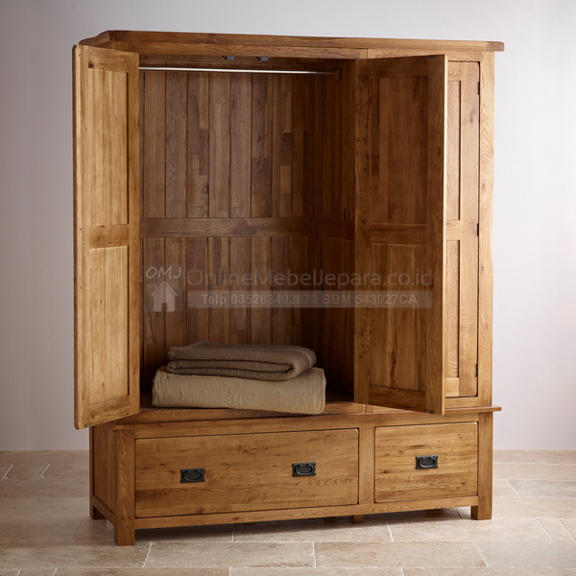
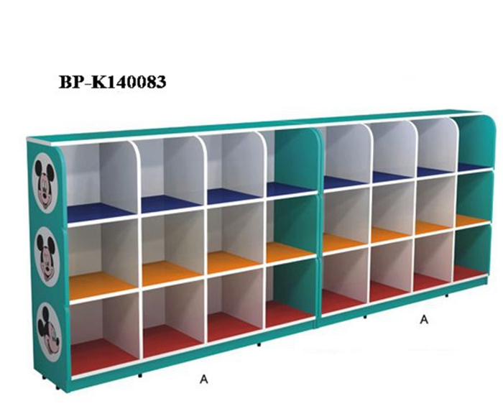
VARIABEL
ARRAY

Slide 4
07. Array
Konsep Array
Pendefinisian dan Pemanggilan Array
Macamnya Array Berdasarkan Jumlah Baris Kolom

Slide 5
1) Konsep Array

Slide 6
Konsep Array
Array is a Special Variabel which can hold more than one value at a time.
Reason:
VARIABEL
$cars1=“Volvo”;
$cars2=“BMW”;
$cars3=“Toyota”;
$cars4=“Datsun”;
$cars5=“Daihatsu”;
….
….
….
$cars-n=“ ”;
SPECIAL VARIABEL / ARRAY
$cars[0]=“Volvo”;
$cars[1]=“BMW”;
$cars[2]=“Toyota”;
$cars[3]=“Datsun”;
$cars[4]=“Daihatsu”;
….
….
….
$cars-n=“ ”;
SPECIAL VARIABEL/ ARRAY
$cars = array("Volvo", "BMW", "Toyota", “Datsun", “Daihatsu“,” “);

Slide 7
2) Pendefinisian dan Pemanggilan Array
Indexed array
Associative array

Slide 8
Pendefinisian ➔ Deklarasi/Taruh
Pemanggilan ➔ Inisialisasi/Akses-Ambil
Pendefinisian : deklarasi sebuah array yang selanjutnya dapat mengisinya.
Pemanggilan : pengaksesan atau penggunaan data dalam array.
2 caranya:
Indexed array
Associative array
A
H
K

Slide 9
a) Indexed Arrays
The index can be assigned automatically (index starts at 0).
Tanpa definisi indeks, indeks diambil dari urutan.
nama_array
⬅ Isi/
value
Index [0] | Index [1] | Index [2] | Index [3] | Index [4] | Index [5] | Index [...]
⬅ alamat
cars
Volvo | BMW | Toyota | Daihatsu
Index [0] | Index [1] | Index [2] | Index [3]
Sintaks Dasar
$nama_array=array(“isi_index0”,“isi_index1”, “isi_index_ke-n”);
Contoh Pendefinisian
$cars = array("Volvo", "BMW", "Toyota“, “Daihatsu“);
Contoh Pemanggilan
echo "I like ".$cars[0].",".$cars[1]." and ".$cars[2].".";

Slide 10
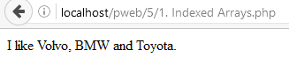
Contoh Index Arrays
cars
Volvo | BMW | Toyota
Index [0] | Index [1] | Index [2]
SCRIPT
OUTPUT
<!DOCTYPE html>
<html>
<head>
<title>Index Array</title>
</head>
<body>
<?php
$cars = array("Volvo", "BMW", "Toyota");
echo "I like " . $cars[0] . ", " . $cars[1] . " and " . $cars[2] . ".";
?>
</body>
</html>

Slide 11
b) Associative Arrays
are arrays that use named keys that you assign to them.
nama_array
⬅ Isi
nama_larik_1 | nama_larik_2 | nama_larik_3 | nama_larik_4 | nama_larik_ke-n
⬅ alamat
umur
44 | 25 | 26
agung | hikma | danti
SINTAKS DASAR 1
$nama_array=array(“namaisiarray1”=>”value1”, “namaisiarray2”=>”value2”, “namaisiarray3”=>”value3”);
SINTAKS DASAR 2
$nama_array[‘namaisiarray1’]=“value1”;
$nama_array[‘namaisiarray2’]=“value2”;
$nama_array[‘namaisiarray3’]=“value3”;

Slide 12
2 Sintaks Assosiative Arrays
umur
44 | 25 | 26
agung | hikma | danti
SINTAKS DASAR 1
$nama_array=array(“namaisiarray1”=>”value1”, “namaisiarray2”=>”value2”, “namaisiarray3”=>”value3”);
Contoh Pendefinisian – SD 1
$umur = array(“agung"=>“44",“hikma"=>“25",“danti"=>“26");
Contoh Pemanggilan – SD 1
echo “Umur danti " . $umur['danti'] . " tahun.";
SINTAKS DASAR 2
$nama_array[‘namaisiarray1’]=“value1”;
$nama_array[‘namaisiarray2’]=“value2”;
$nama_array[‘namaisiarray3’]=“value3”;
Contoh Pendefinisian – SD 2
$umur[‘agung'] = “44";
$umur[‘hikma'] = “25";
$umur[‘danti'] = “26";
Contoh Pemanggilan – SD 2
echo “Umur danti " . $umur[danti'] . " tahun.";

Slide 13
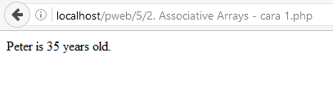
Contoh Associative Arrays - SD 1
SCRIPT
OUTPUT
<!DOCTYPE html>
<html>
<head>
<title>Assosiative SD1</title>
</head>
<body>
<?php
$age = array("Peter"=>"35", "Ben"=>"37", "Joe"=>"43");
echo "Peter is " . $age['Peter'] . " years old.";
?>
</body>
</html>
umur
44 | 25 | 26
agung | hikma | danti

Slide 14
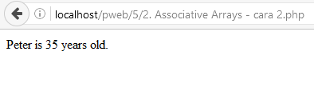
Contoh Associative Arrays - SD 2
SCRIPT
OUTPUT
<!DOCTYPE html>
<html>
<head>
<title>Assosiative SD 2</title>
</head>
<body>
<?php
$age['Peter'] = "35";
$age['Ben'] = "37";
$age['Joe'] = "43";
echo "Peter is " . $age['Peter'] . " years old.";
?>
</body>
</html>
umur
44 | 25 | 26
agung | hikma | danti

Slide 15
3) Macamnya Array Berdasarkan Jumlah Baris Kolom
Array dimensi satu
Array dimensi dua
Array dimensi banyak

Slide 16
Macamnya Array Berdasarkan Jumlah Baris Kolom
Mendasarkan kategorinya berdasarkan dimensi/ jumlah baris kolomnya.
Pembagiannya adalah:
Array dimensi satu
Array dimensi dua
Array dimensi banyak.

Slide 17
a) Array Dimesi Satu
Hanya memiliki nilai sumbu x.
Struktur Dasar:
nama_array
Index → | Index[0] | Index[1] | Index[2] | Index[…]

Slide 18
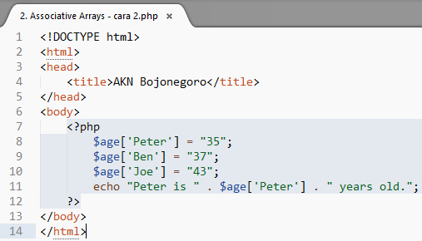
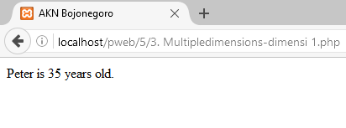


Contoh Array Dimensi Satu
SCRIPT (associative-index)
OUTPUT

Slide 19
b) Array Dimensi Dua
Memiliki nilai sumbu x dan y.
Struktur Dasar:
Pendefinisiannya: Namaarray[indexbaris][indexkolom]
BARIS
KOLOM
Indexbaris[0]
Indexbaris[1]
 | Indexkolom[0] | Indexkolom[1] | Indexkolom[2]

Slide 20
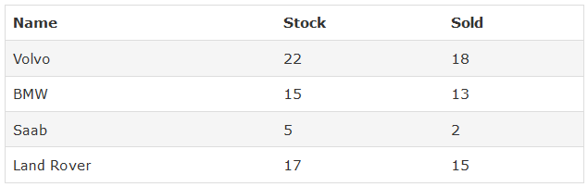
Contoh Array Dimensi Dua
SCRIPT (mengisi array)
CONCEPT
<?php
$cars = array
(
array("Volvo",22,18),
array("BMW",15,13),
array("Saab",5,2),
array("Land Rover",17,15)
);
?>
I_baris[0] | [0][0] | [0][1] | [0][2]
I_baris[1] | [1][0] | [1][1] | [1][2]
I_baris[2] | [2][0] | [2][1] | [2][2]
I_baris[3] | [3][0] | [3][1] | [3][2]
 | I_kolom[0] | I_kolom[1] | I_kolom[2]

Slide 21
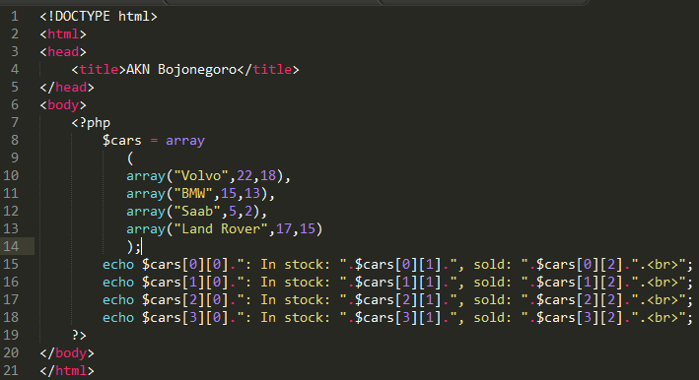
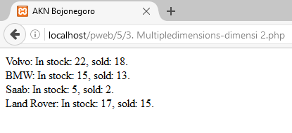
Contoh Array Dimensi Dua (2)
SCRIPT (mengisi dan menampilkan array)
OUTPUT
CONCEPT
I_baris[0] | [0][0] | [0][1] | [0][2]
I_baris[1] | [1][0] | [1][1] | [1][2]
I_baris[2] | [2][0] | [2][1] | [2][2]
I_baris[3] | [3][0] | [3][1] | [3][2]
 | I_kolom[0] | I_kolom[1] | I_kolom[2]

Slide 22
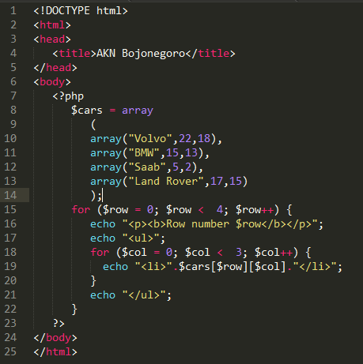
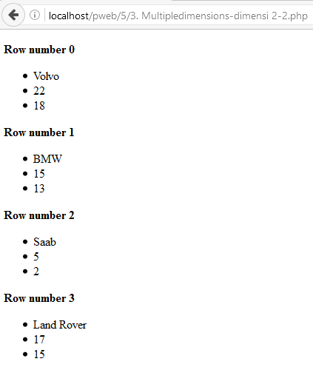
Contoh Array Dimensi Dua (3)
SCRIPT
OUTPUT

Slide 23
c) Array Dimensi Tiga
Memiliki nilai sumbu x, y, dan z.
Struktur Dasar:
Pendefinisiannya:
Namaarray[indexlayer][indexbaris][indexkolom]
Indexbaris[0]
Indexbaris[1]
 | Indexkolom[0] | Indexkolom[1] | Indexkolom[2]
sumbu z, layer 3
sumbu z, layer 2
sumbu z, layer 1

Slide 24
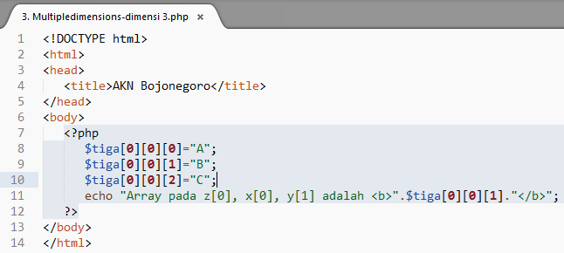
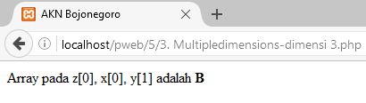
Contoh Array Dimensi Tiga
SCRIPT
CONCEPT
[0]
[0] | A | B | C
[1] | D | E | F
 | [0] | [1] | [2]
[1]
[0] | G | H | I
[1] | J | K | L
 | [0] | [1] | [2]
OUTPUT
[2]
[0] | M | N | O
[1] | P | Q | R
 | [0] | [1] | [2]

Slide 25
Referensi (1)
Andrea Tar. 2012. PHP and MySQL 24-Hour Trainer
Brett McLaughlin. 2012. PHP & MySQL- The Missing Manual. USA-Brett McLaughlin. USA-O'REILLY Media
Brett McLaughlin. 2013. PHP & MySQL- The Missing Manual, 2nd Edition. USA-Brett McLaughlin. USA-O'REILLY Media
Deitel, Harvey and Paul Deitel. 2007. Internet & World Wide Web, How to Program. 4th Edition. Prentice Hall
Fadila, Armando dkk. Pro PHP Application Performance
Gilmore, W. Jason. 2010. Beginning php and mysql from novice to professional, 4th edition
Head First PHP & MySQL
Kroenke, David. 2013. Database Processing 12th Edition
Lamandi, BB dkk. 2009. AJAX and PHP Building Modern Web Applications, 2nd Edition
LesLie. Web Standards Mastering HTML5, CSS3, dan XML
Loka Dwiartara. Menyelam dan Menaklukan Samudra PHP
Michcel, Lorna Jane. PHP Web Services
Mysql Official. 2016. MySQL 5.7 Reference Manual-en
Official. php_manual_en
PHP6 and MySQL Bible by Steve Suehring

Slide 26
Referensi (2)
Power, David. PHP Solutions, 3rd Edition
Powers, David. 2010. PHP Solutions Dynamic Web Design Made Easy 2nd Edition. Friendsoft-Apress company-USA
Robert W. Sebesta. 2014. Programming the World Wide Web 2014 (8th Edition). Addison Wesley
Rochkin Mark. 2013. Expert PHP and MySQL
Rosihanari. Basic PHP Tutorial
Ruehning, dkk. php_mysql_javascript__html5_all-in-one_for_dummies
Sams.Sams.Teach.Yourself.PHP.MySQL.and.Apache.All-in-One.ISBN0672326205
Solichin, Achmad. Pemrograman Web dengan PHP MySQL
Tatro, Kvein, dkk. 2013. Programming PHP, 3rd Edition. USA-O'REILLY Media
Tutorialpoints.com - mysql tutorial
Valade, Janet. PHP & MySQL Web Development All-in-One Desk Reference For Dummies. CanadaWiley Publishing,Inc
W3Schools Offline 2018
Wahono, Romi Satria. dasar-php
Welling, Luke and Laura Thomson. 2015. Welling php mysql web 3rd. USA - Sam Publishing
Widigdo, Anon Kuncoro. 2003. php dan mysql
Zandstra, Matt. PHP Objects, Patterns, and Practice, 4th Edition

